Slide 1
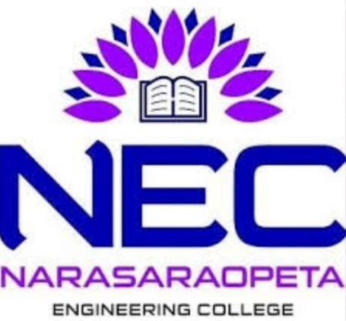
NARASARAOPETA ENGINEERING COLLEGE (AUTONOMOUS) Text+Image Multimodel Search using MobileNet Under the faculty guidance of Shaik Rafi, M.tech,(Ph.d)
Team members
D.Hemanth kumar (19471A0514)
P. naveen (19471A0547)
P. Pavan kumar (19471a0543)

Slide 2
Contents
Abstract
Introduction
System Requirements
Existing system
Proposed system
Methodology
MobileNet CNN
BERT
Process
Advantages
Dataset Link
Output
Conclusion

Slide 3
Abstract
Multi-modal search is a task of retrieving relevant results from a database using multiple modalities such as text and images
The goal of multi-modal search is to provide more accurate and comprehensive search results by integrating different types of data.
This technique is widely used in various domains such as e-commerce, healthcare, social media, and entertainment.
Multi-modal search requires the use of various techniques such as feature extraction, similarity measures, and machine learning algorithms.
With the increasing availability of multi-modal data, multi-modal search has become an important area of research in the field of information retrieval and computer vision.

Slide 4
Introduction
Multimodal search is a type of search technique where the system retrieves results based on the user's query using different modalities, such as text, image, audio, and video. It combines different modalities to achieve more accurate and relevant search results.
In a typical multimodal search system, the input query may consist of text, image. The system extracts relevant features from each modality and combines them to form a joint feature representation.The joint representation is then used to retrieve relevant results based on the user's query
For example, in an e-commerce website, the user may enter a query for a product, and the system may retrieve results based on the text description of the product, as well as the image of the product.

Slide 5
System Requirements
Hardware Requirements:
Processor: i5 processor or higher version
Hard Disk: 30 GB or more
RAM : 2 GB or more
Software Requirements:
Operating System : Windows 11
Programming Language : Python
Editor : Google Colab
Browser : Any Latest Browser like Chrome

Slide 6
Existing System
In the Existing system of many e-commerce websites users can only give either text discription or image as input.
It uses GPT for text classification and MobileNetV2 for image Classification.
Need high configuration devices and need more Hardware resources.
Proposed system
The proposed system proposes a multi-modal search method based on MobileNet CNN and BERT.
In this system we get the similar images and text for the given input text and image from the Database according to the given query.
User can give both text and image at a time as input.
In the proposed system it performs on google GPU. It does not depends on system configuration.
It takes over 174 sec to get Image Embeddings and Text Embeddings for 20550 train images.

Slide 7
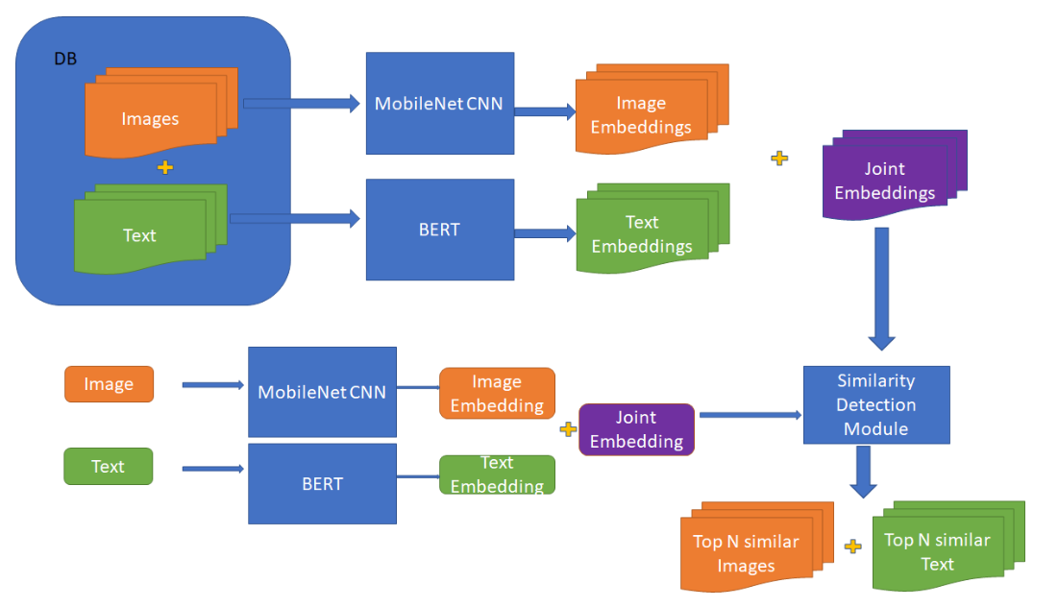
Methodology

Slide 8
MobileNet CNN for Image Classification:
MobileNet is a type of convolutional neural network (CNN) used for image classification tasks. It was designed to be lightweight and efficient, making it well-suited for use on mobile devices with limited computing power.
MobileNet achieves its efficiency by using a technique called depthwise separable convolution. This technique separates the standard convolution operation into two separate operations: a depthwise convolution and a pointwise convolution.
Lightweight: MobileNet is a very lightweight architecture compared to other deep neural networks, which makes it ideal for use on mobile devices with limited processing power.
High accuracy: Despite its small size, MobileNet achieves high accuracy in image classification tasks, which is essential for applications such as object recognition, facial recognition, and image segmentation.
Energy-efficient: MobileNet consumes less energy compared to other deep neural networks, which is a crucial factor for mobile devices with limited battery life.
Fast inference: The architecture of MobileNet is optimized for fast inference, allowing it to process images quickly and efficiently on mobile devices.

Slide 9
BERT
BERT (Bidirectional Encoder Representations from Transformers) is a type of language model developed by Google that uses deep learning techniques to understand the meaning of words in a sentence. It is considered to be one of the most powerful language model.
Bidirectionality: BERT is bidirectional, which means it can take into account the context of a word from both its preceding and following words. This allows BERT to better understand the meaning of a sentence and the relationship between words.
Pre-training: BERT is pre-trained on a large corpus of text data, which helps it understand the nuances of language and the relationships between words in real-world contexts. This pre-training allows BERT to be fine-tuned on smaller datasets for specific NLP tasks, which can save time and improve accuracy.
Transfer learning: BERT's pre-training allows it to transfer knowledge to new NLP tasks with little or no additional training, which is known as transfer learning. This can save significant time and resources in developing new NLP models.
State-of-the-art performance: BERT has achieved state-of-the-art performance on a wide range of NLP tasks, including text classification, question answering, and language translation.

Slide 10
Nearest neighbor algorithm
The nearest neighbor algorithm is a simple machine learning algorithm that can be used for classification and regression tasks.
It works by finding the data point(s) in the training set that are closest to the test data point, and assigning the label or value of the closest training data point(s) to the test data point.
The algorithm calculates the distance between the test data point and each training data point, and selects the closest one(s) as the nearest neighbor(s).
Cosine similarity
Cosine similarity is a measure of similarity between two vectors in a high-dimensional space.
It measures the cosine of the angle between the two vectors, with values ranging from -1 (opposite direction) to 1 (same direction), and 0 indicating no similarity.
It is commonly used in natural language processing and recommendation systems, where the vectors represent words or items, and the similarity measures the relatedness or relevance between them.

Slide 11
Process
Reading the Text and Image Datasets: The first step in building a multi-model search system for text and images is to read the datasets that will be included in the search. These could include databases of text documents, image repositories, or other sources of information
Data processing: Once the datasets have been read, the data needs to be processed. This involves cleaning and training of the data .Here we are using transfer learning instead of training the whole data.
Text Embedding: The text data needs to be Embedded so that it can be searched quickly and efficiently. This involves creating the vectors for the text data.
Image Embedding: The image data needs to be Embedded as well. In order to do this, features from the photos, such as colours, forms, and textures, must be extracted using computer vision algorithms.
Joint Embedding: It is a powerful technique for integrating multiple types of data like images and text into a common representation space, allowing for more efficient and effective analysis and processing of multimodal data.
Query Processing: When a user enters a search query, the system will process the query and search across both the text and image datasets. This involves comparing the input joint embedding with other data in dataset using similarity detecttion models like cosine similarity etc. to provide the best results.
Machine Learning: To improve the accuracy and relevance of search results, the machine learning techniques can be applied. To enhance text search results, for instance, natural language processing (NLP) models might be applied, while image recognition models can be used to improve image search results. Large volumes of data can be used to train these models to find patterns and relationships in the data that can be utilised to enhance search results.

Slide 12
Advantages
No need of more hardware resources.
Fast performance and higher accuracy.
Not necessary of high configuration devices.
No need to train the whole dataset due to using of transfer learning.
It runs on GPU memory.
Dataset Link:
https://www.kaggle.com/competitions/shopee-product-matching/data
.

Slide 13
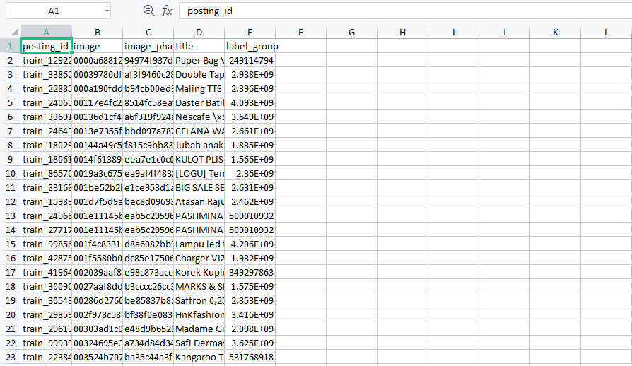
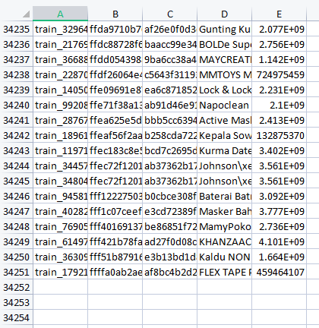
Train.csv file:

Slide 14
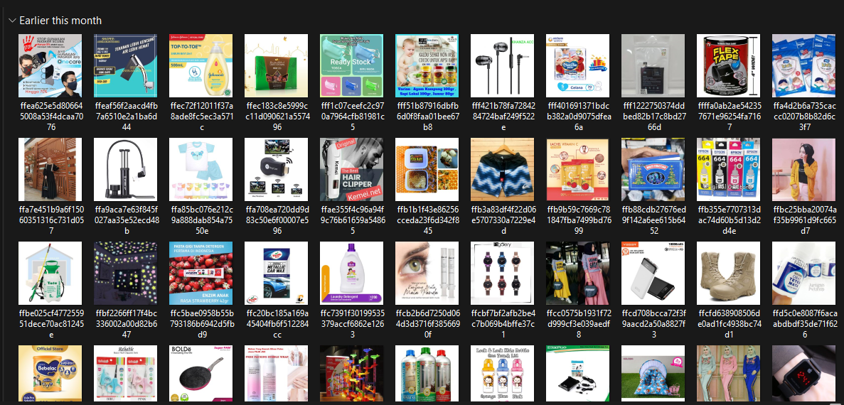
Train_images file:

Slide 15
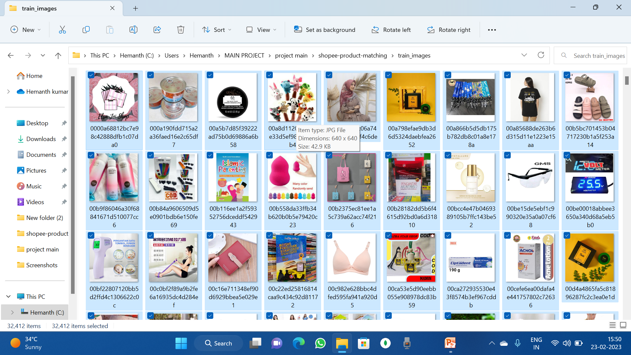

Slide 16
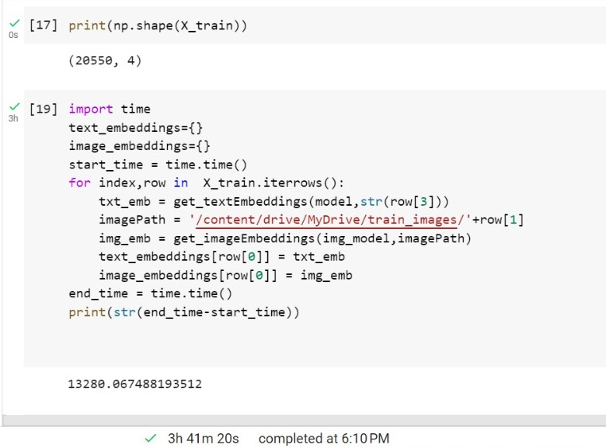
Time complexity: on CPU

Slide 17
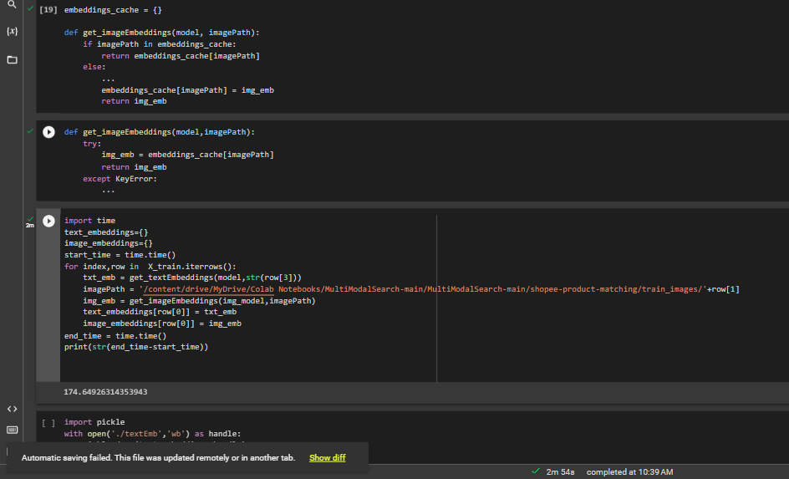
Time complexity: on GPU

Slide 18
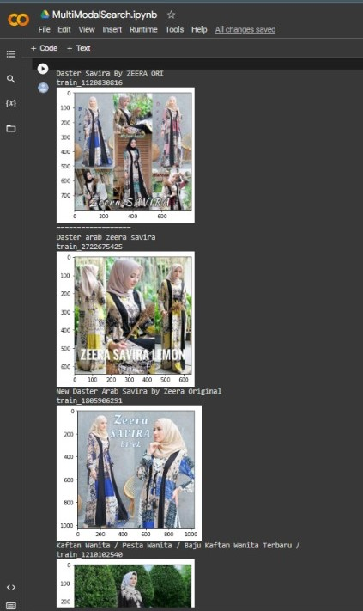
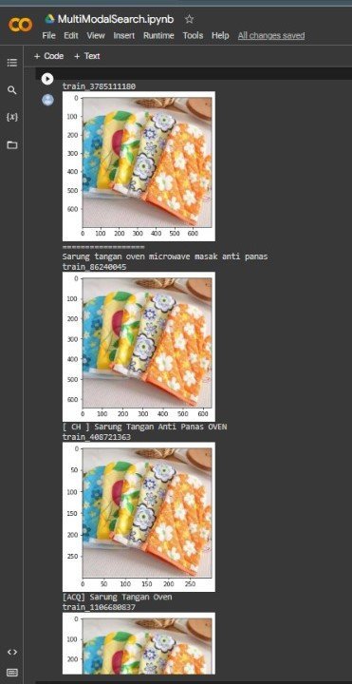
Output:

Slide 19
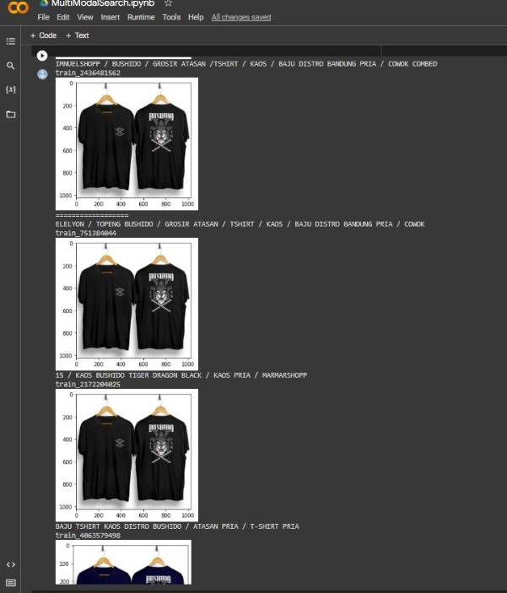
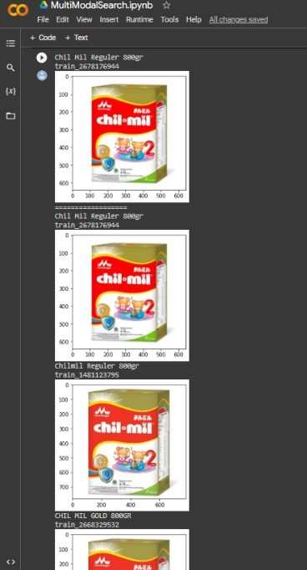

Slide 20
Conclusion
Multimodal search is a powerful and growing area of research in the field of information retrieval. By combining different modalities, such as text, images, and videos, multimodal search can provide more accurate and relevant results than traditional text-based search methods.
One of the key challenges in multimodal search is the need to effectively integrate and process data from multiple modalities. This can be achieved through the use of joint embedding, which allows for the learning of a shared representation space that captures the relationships between different modalities.
Recent advances in deep learning and natural language processing have enabled the development of state-of-the-art models, such as BERT and GPT-3, that can be fine-tuned for specific NLP tasks and combined with other modalities in a joint embedding space. These models have shown great promise in improving the accuracy and efficiency of multimodal search applications.
Overall, multimodal search is a rapidly evolving field with many exciting opportunities for research and development. As technology continues to advance, we can expect to see continued progress in the development of more sophisticated and effective models for multimodal search.

Slide 21


